Slide 1
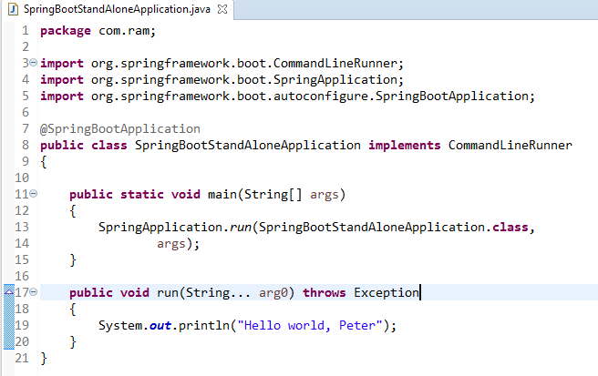
Spring Boot – Runners [Command Line Runner]
Command Line Runner is an interface. It is used to execute the code after the Spring Boot application started.

